Slide 1

Geospatial analysis of the most suitable areas in Europe to set up an alpaca farm
Manon Salles - Hugo Chevalier
RUDN2 with Naci Dilekli

Slide 2
Content
Workflow​
Data Import​
Algorithm
Temperature comparison​
Delimited Area of Europe​
Data Normalization​
User Criterion​
Final Maps​
Question
First Map
Conclusion

Slide 3
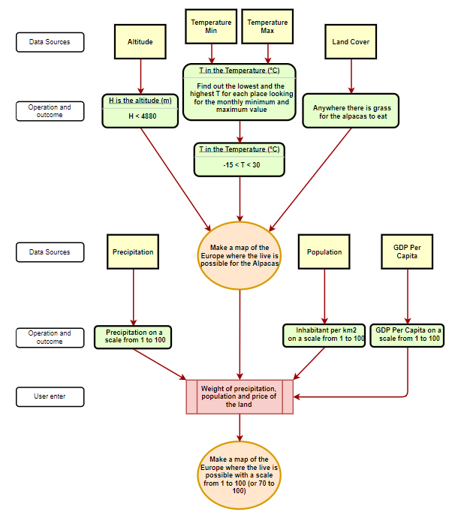
Workflow

Slide 4
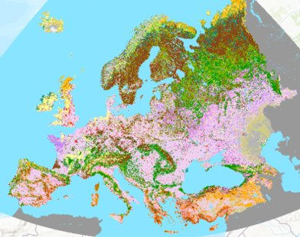
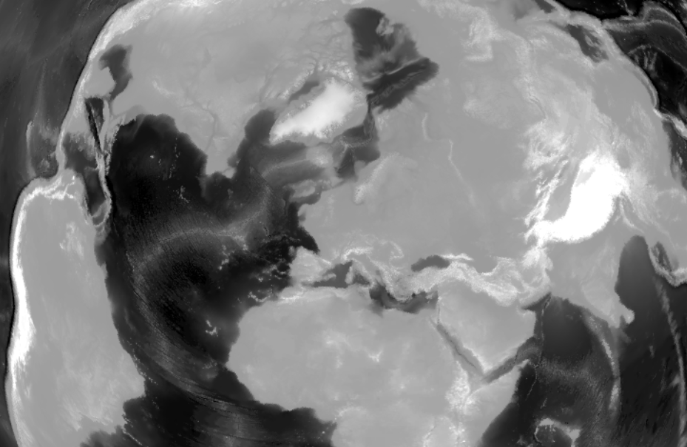
Data Import

Slide 5
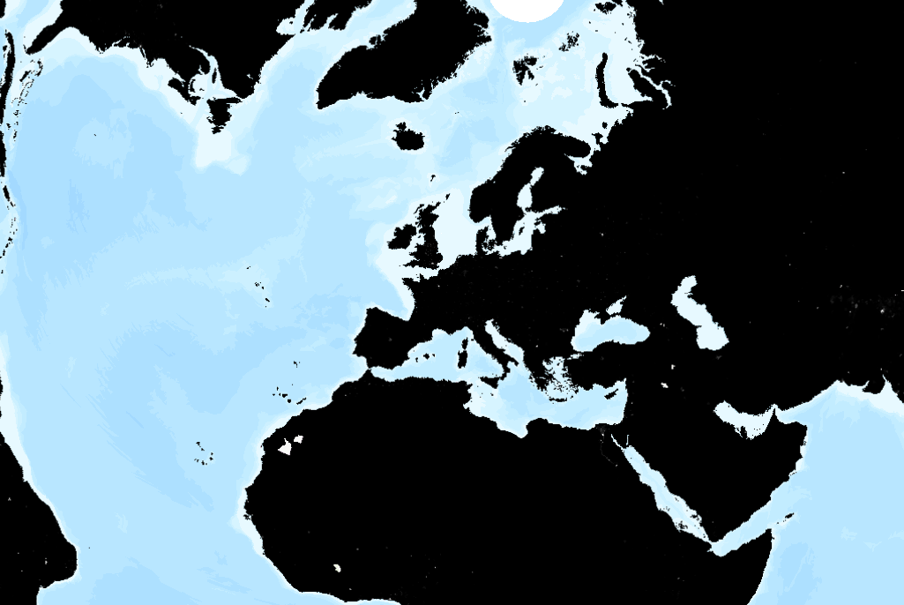
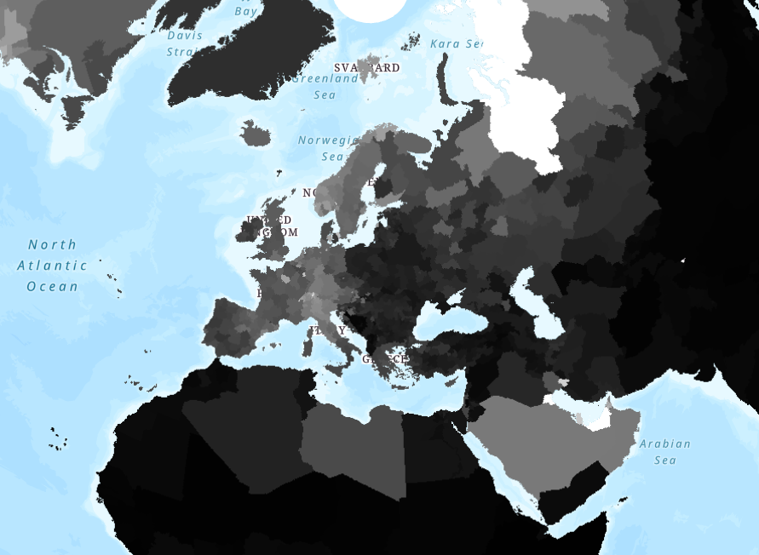
Data Import

Slide 6
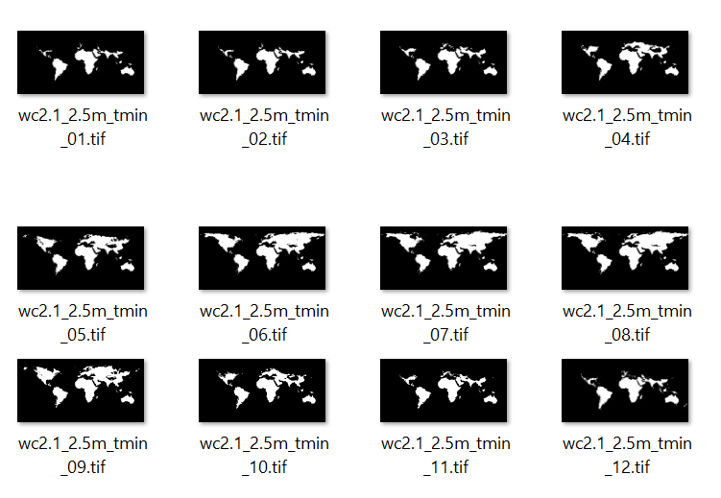
Data Import

Slide 7
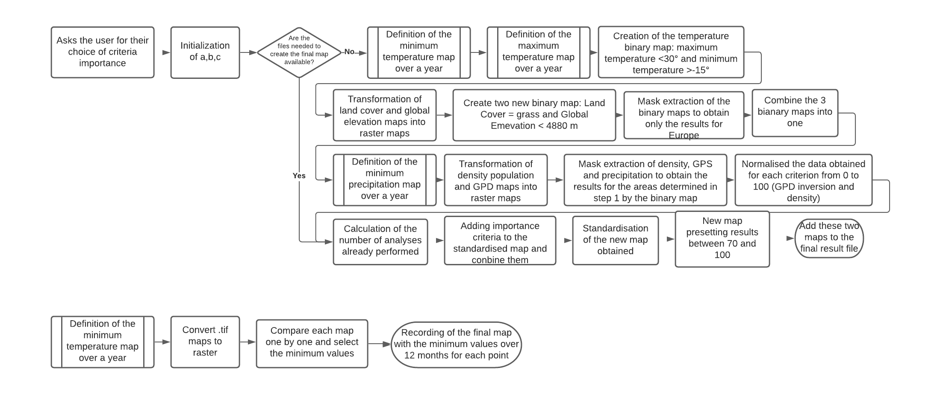
Algorithm

Slide 8
Algorithm

Slide 9
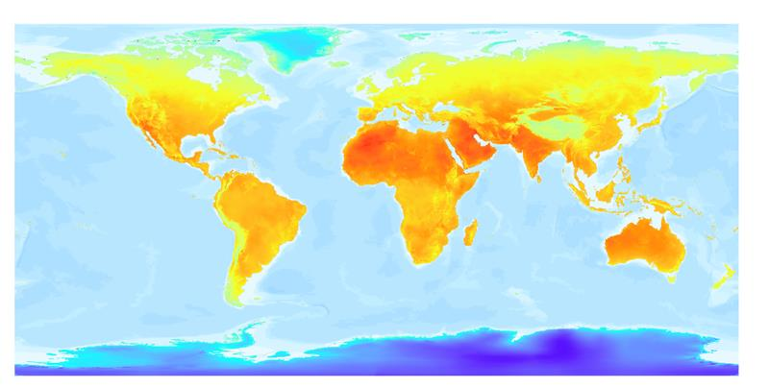
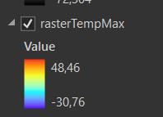
Temperature Comparison (Max)

Slide 10
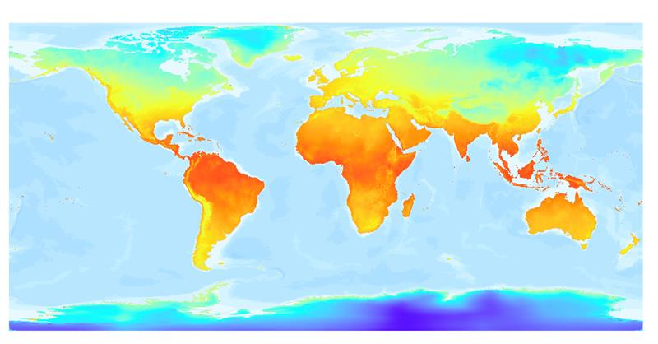
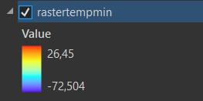
Temperature Comparison (Min)

Slide 11
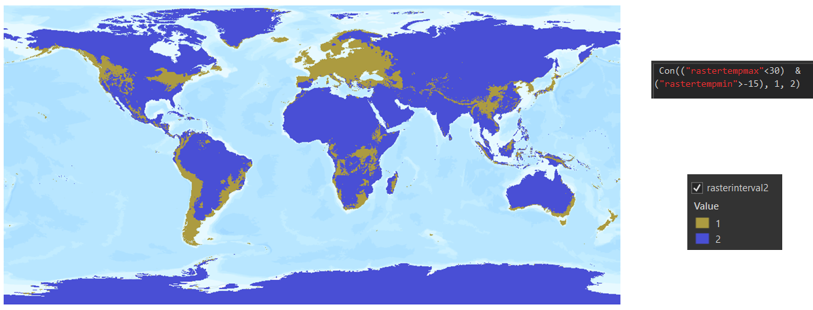
Temperature Comparison

Slide 12
Algorithm

Slide 13
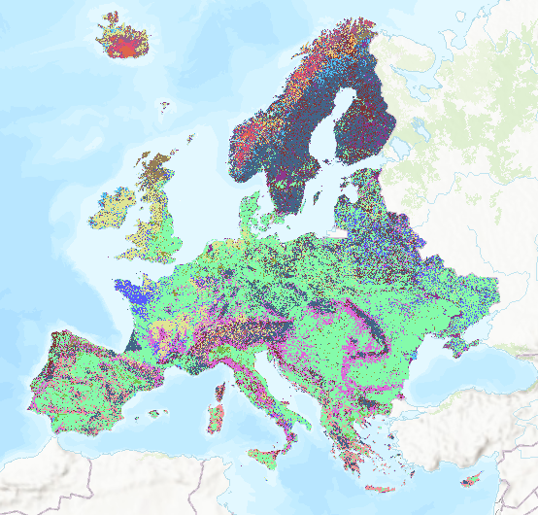
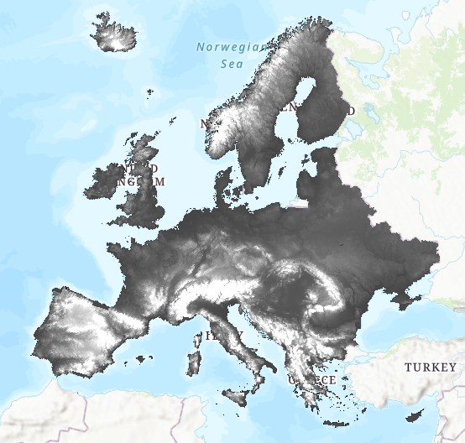
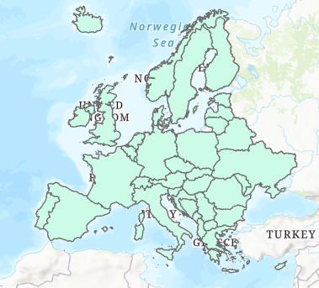
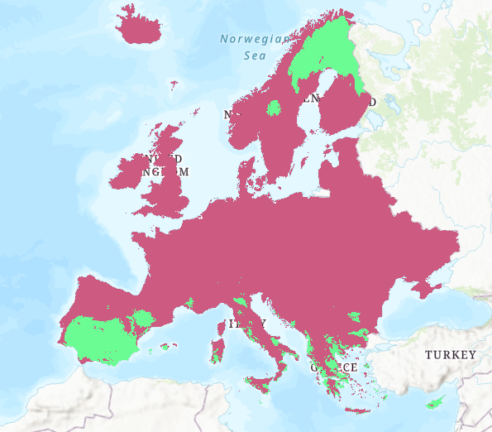
Delimited Area of Europe

Slide 14
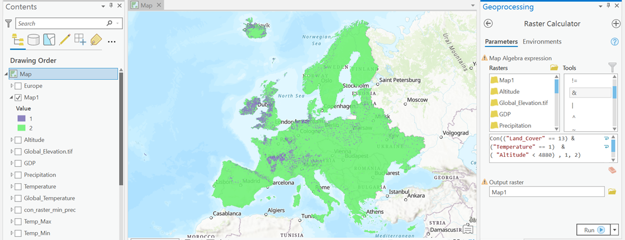
First Map

Slide 15
Algorithm

Slide 16
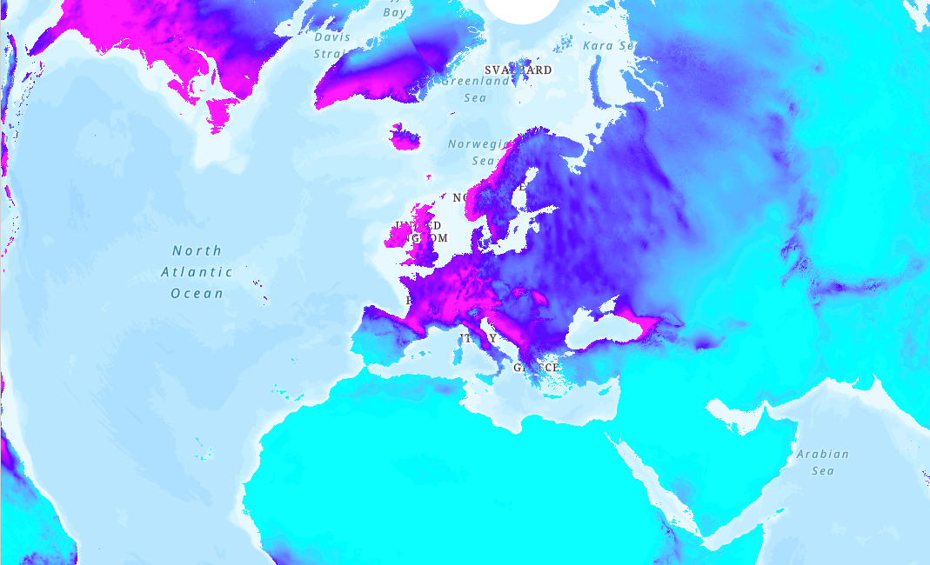
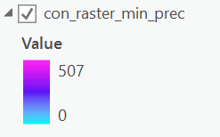
Precipitation Comparison (min)

Slide 17
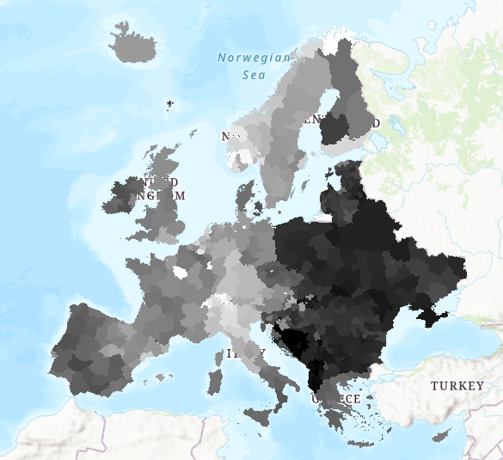
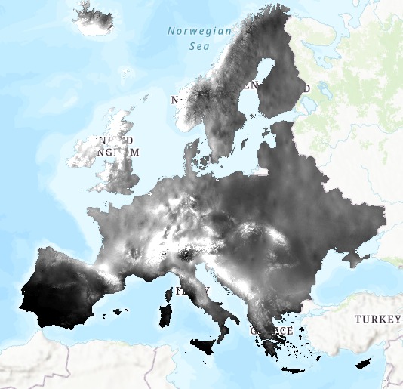
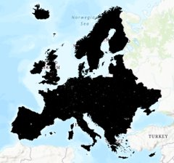
Delimited Area of Europe

Slide 18
Algorithm

Slide 19
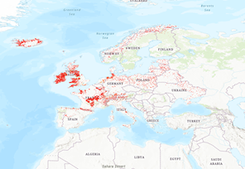
Data Normalization (Population Density)

Slide 20
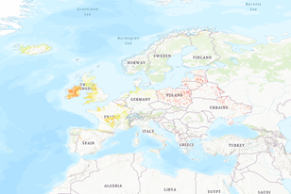
Data Normalization (GDP Per Capita)

Slide 21
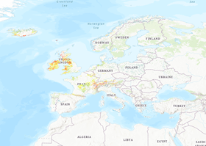
Data Normalization (Precipitation)

Slide 22
Algorithm

Slide 23
User Enter

Slide 24
Algorithm

Slide 25
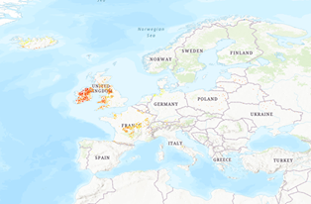
Final Map (From 0 to 100)

Slide 26
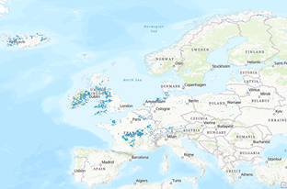
Final Map (From 70 to 100)

Slide 27







Conclusion
Project can be used as many times as desired
Makes it easier to repeat actions
Allows the user to enter data
Allows the use of predefined functions
Learn to use ArcGis Pro and Python
Learn the principle of map analysis
Realization of our own project

Slide 28

Question

